Slide 1

Interactive Paint
Team Member(s): Justin Alvarez, Jose Morgan Product Owner(s): Francisco Ortega
Instructor: Masoud Sadjadi School of Computing and Information Sciences Florida International University
Final Presentation
Fall 2016
Notes:
7 seconds.
Greet your audience, thank them for attending your presentation, introduce yourself, introduce your project, introduce your team members, and quickly indicate what each of you did in a high-level manner, and put more emphasis on your part/contribution.

Slide 2
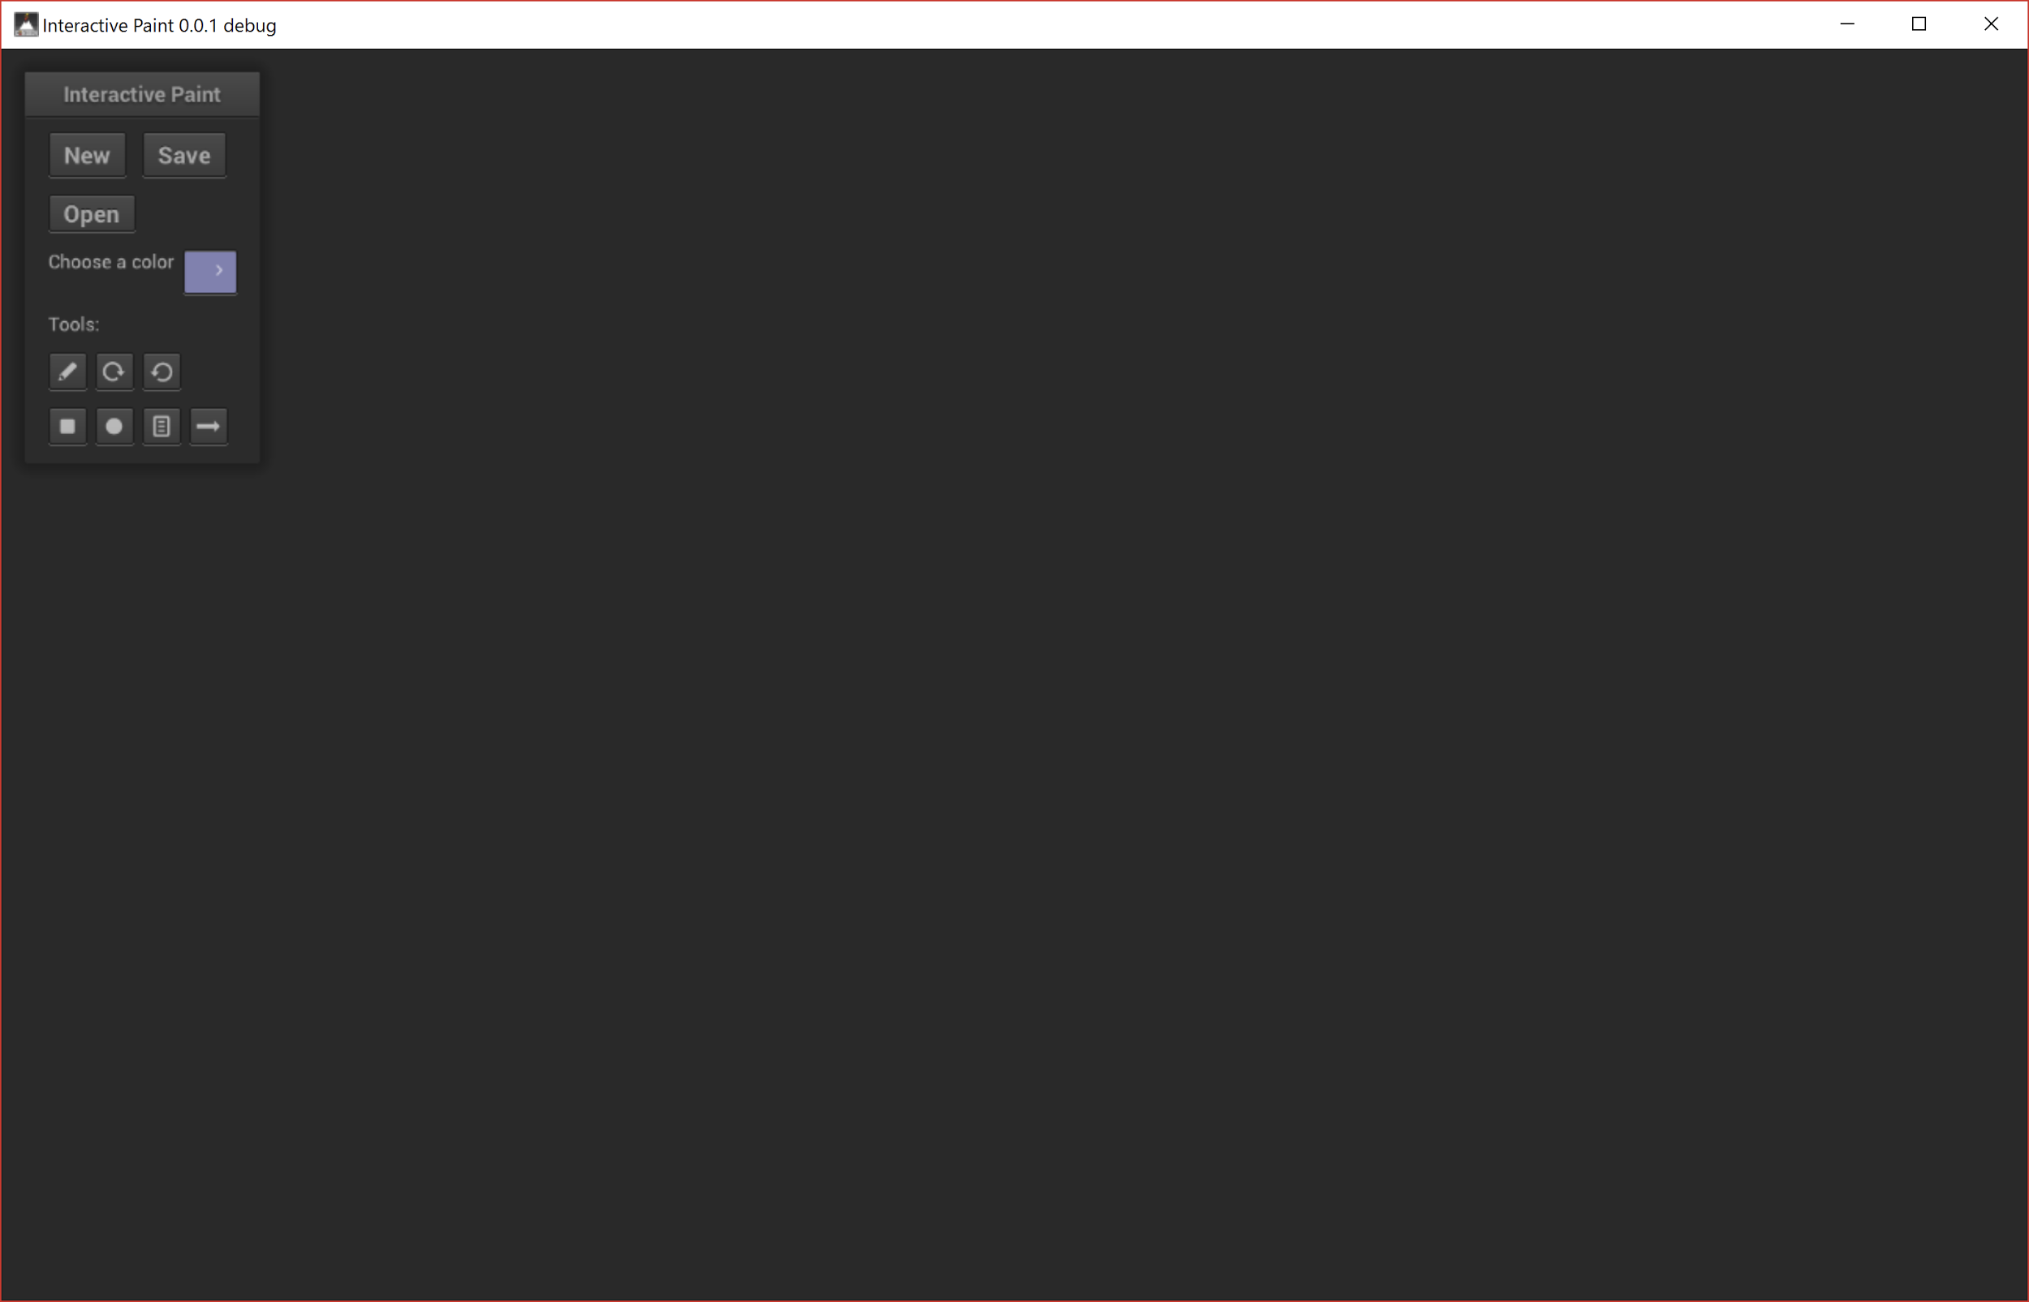
Interactive Paint definition
The Interactive Paint application serves as a showcase of what can be done with different input devices such as the Leap Motion, Intel RealSense, Kinect and Multitouch display. It is also a framework for integrating these devices.
Notes:
10 seconds.
Introduce the problem that the whole project (in all versions) tackles with GIF or screenshot.

Slide 3
Requirements
Future developers should be able to take our framework for input devices and build an application with that.
Users should be able to draw concurrently in the application with the Leap Motion, Kinect, RealSense and Mutlitouch display.
Users should be able to use gestures to interact with the application.

Slide 4
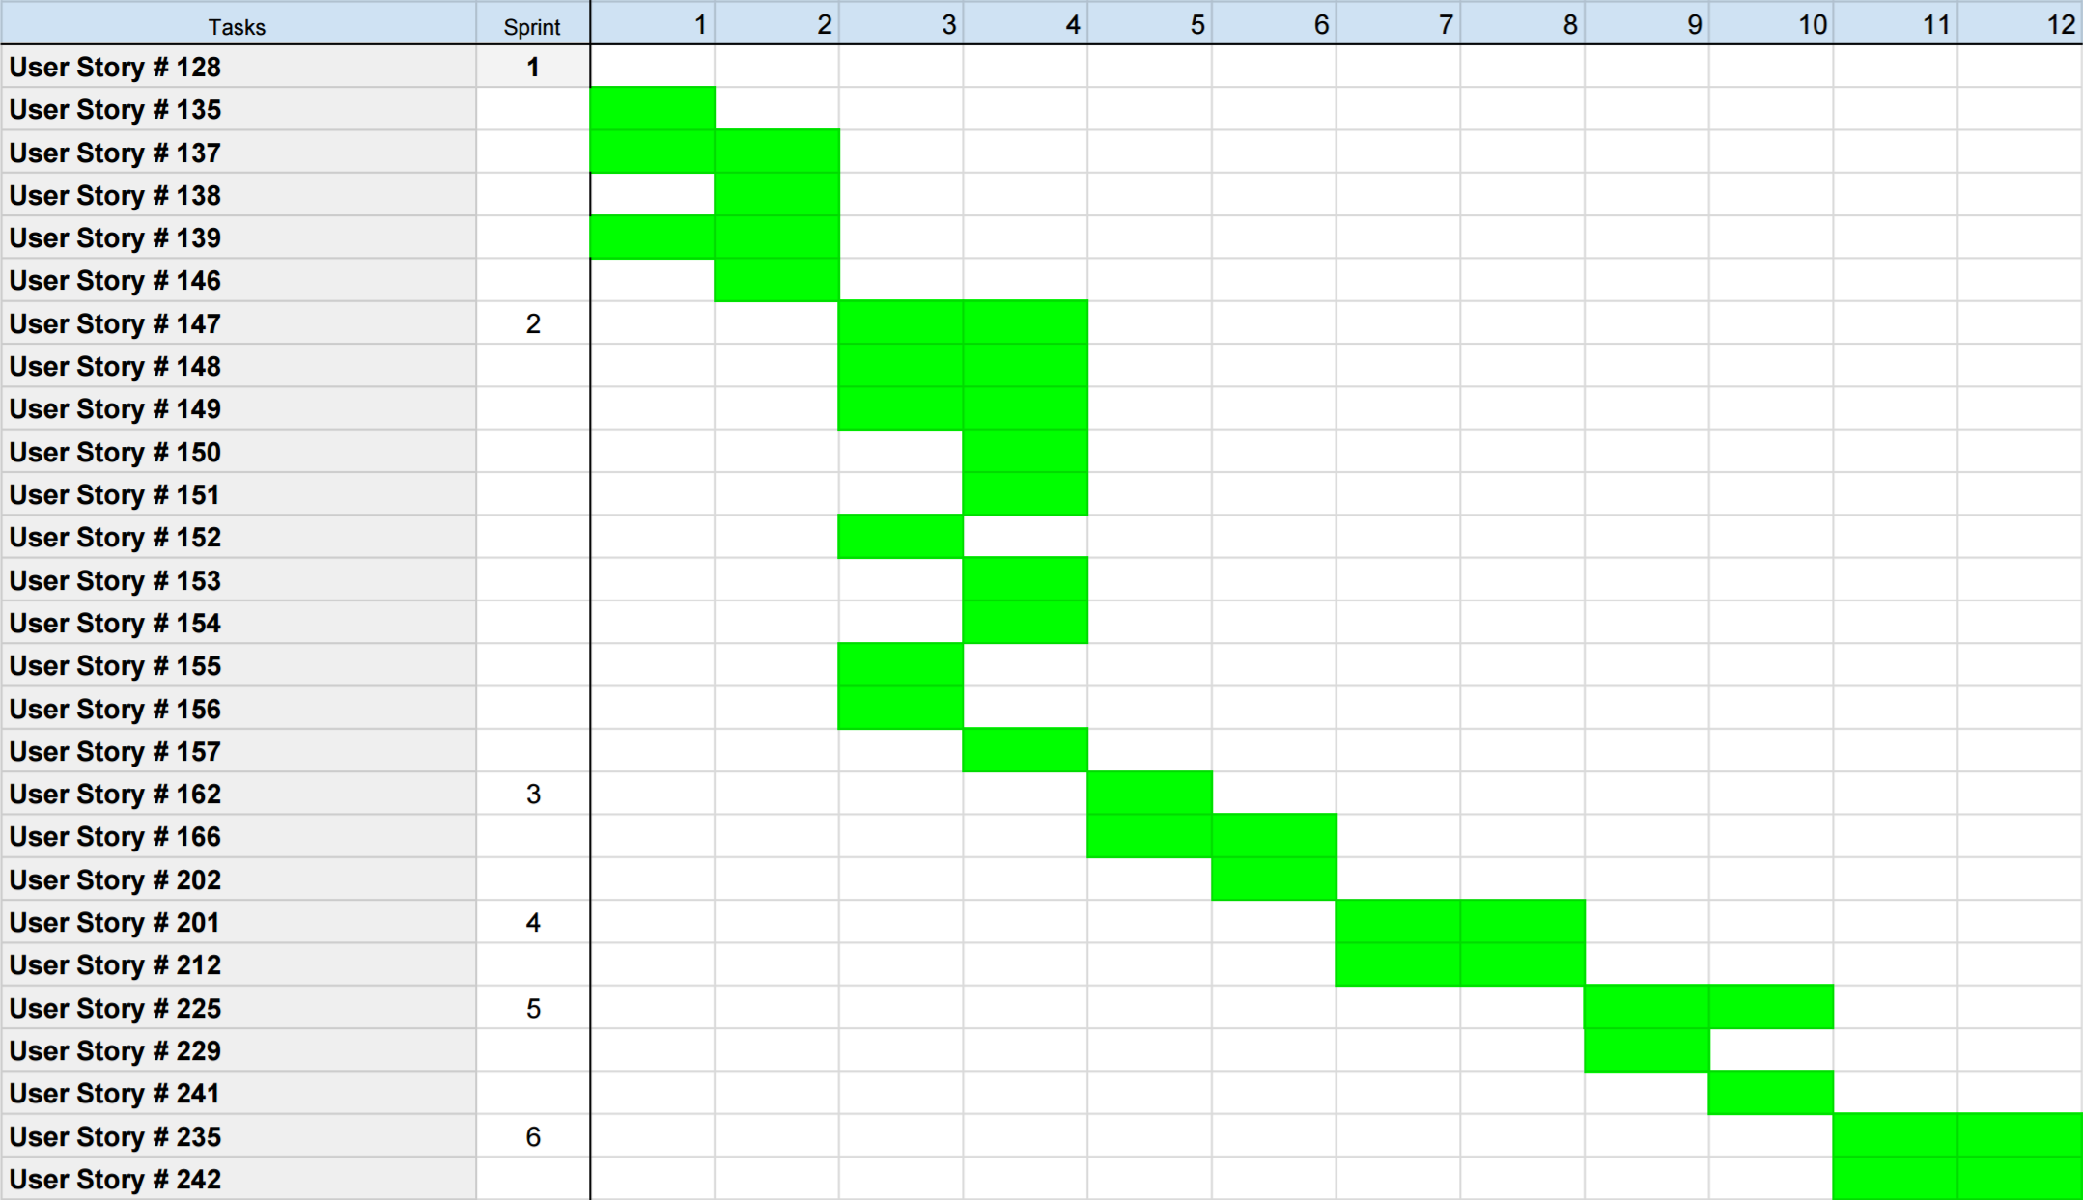
Gantt Chart

Slide 5
System Design: Architecture
Actor Model - Components are independent actors in an application, and all aspects of the interactive paint project have taken advantage of this pattern (Unity).
Object Composition - In an attempt to avoid complex classical hierarchies while programming in a more functional ML manner, we’ve opted to use Object Composition as a mechanism for reuse.
Notes:
20 seconds
System design: Highlight the parts that you contributed to them.
1. System decomposition; identify the architecture patterns used
2. System deployment – h/w and s/w requirements

Slide 6
User Stories
1.User Story #201 - Make input devices work with application
2.User Story #202 - Add tools to new Cinder integrated project
Notes:
5 seconds.
List the user stories that you worked on them.(put in order of importance). Stay focused on the parts that you have been working.

Slide 7
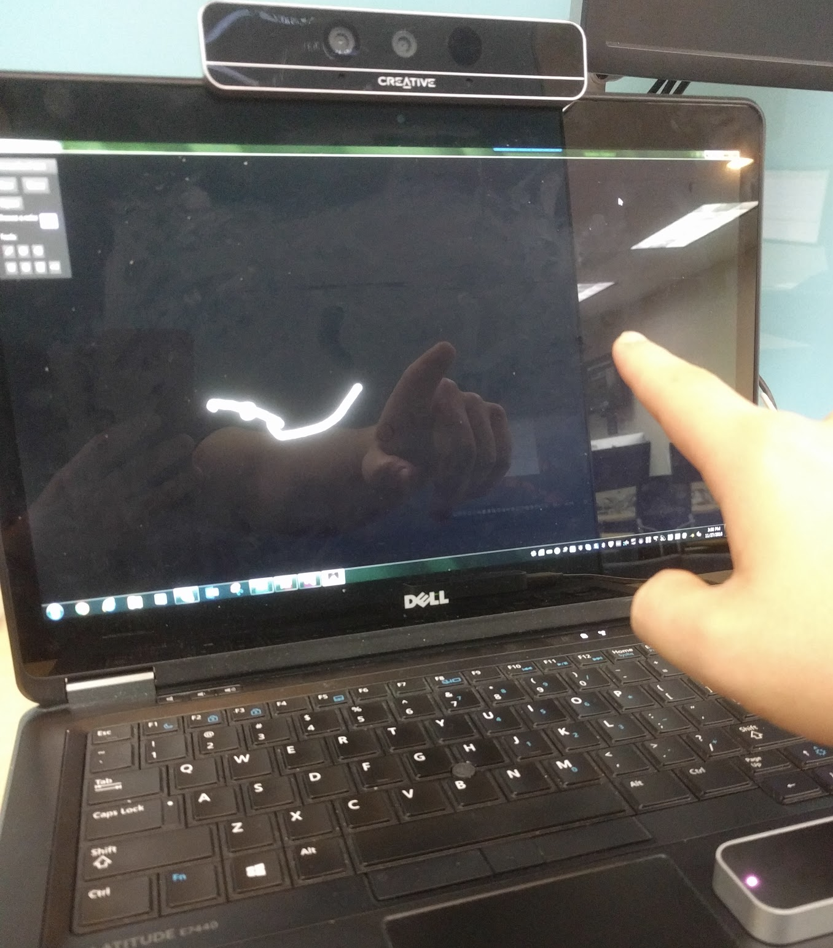
User Story #201
As a user I would want the application to work with multiple input devices such as the Kinect and the Leap Motion.
Acceptance Criteria:
Multiple input devices should be working with the application.
Implementation should be done in such a way that it can be easily switched over to Vulkan once that is ready.
This is when implementation of the handling interactions with input devices began.
Notes:
60 seconds
The tile of user story
The most important user story you worked on it. You have to describe this one very well and be proud of that.
Please present and show the complexity of your work, code, algorithms, and technical challenges and technologies you have used. (you could use screenshot if you want. Visual presentations are better than text presentation)
Go into the details of the most important/significant tasks using bullet lists or visual graphs or state chart diagram
Sequence Diagram for this user story is mandatory (in another separate page if required)
Demo using screenshots or GIF (in another separate page if required)

Slide 8
User Story #202 - Add tools to new Cinder integrated project
User Story #202 - Add tools to new Cinder integrated project
As a user, I want to be able to use some basic tools (New, Save, Line, Rotate, and color select).
Acceptance Criteria:
All tools work
All tools can be composed together
Any other criteria specified in the sub-tasks are met
Tasks:
Testing
Documentation
Color selection tool:
As a user, I would like to be able to select different colors so I can draw colorful pictures.
Rotation tool:
As a user, I would like to be able to press a button to rotate the canvas.
Line drawing tool:
As a user, I want to draw a line on a canvas
Saving and loading files:
As a user, I would like to be able to open a picture file (.png, .jpg, etc) in the interactive paint program. (Will use a nanogui control to load the file and display it using cinder)
Notes:
20 seconds
The tile of user story
Please present and show the complexity of your work, code, algorithms, and technical challenges and technologies you have used. (you could use screenshot if you want. Visual presentations are better than text presentation) - Go into the details of the most important/significant tasks using bullet lists or visual graphs or state chart diagram - Demo using screenshots or GIF (in another separate page if required)
Sequence Diagram for this user story is optional

Slide 9
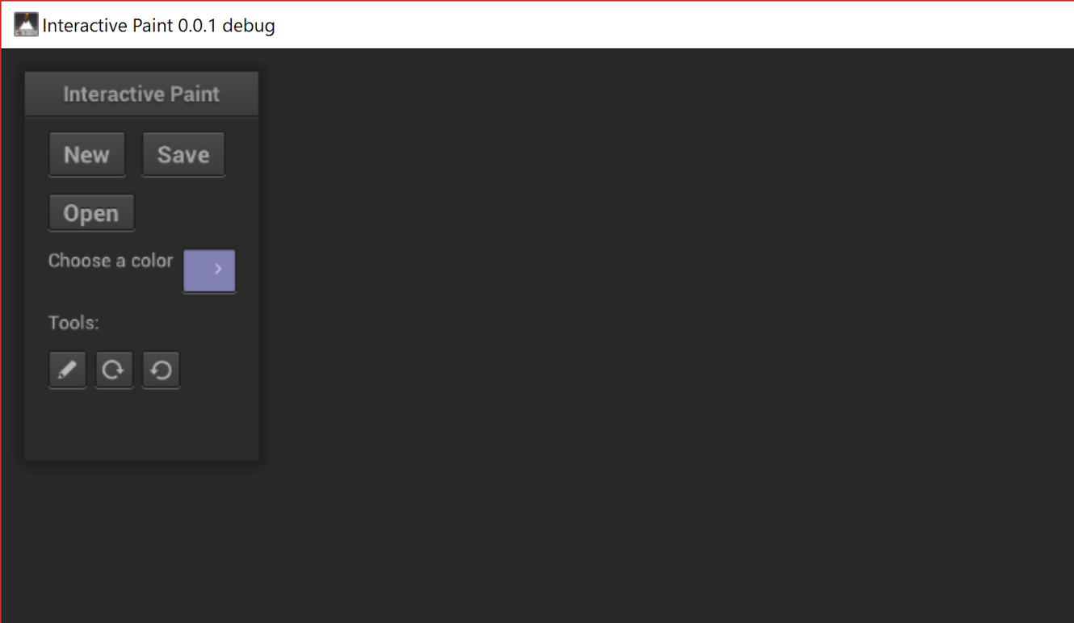
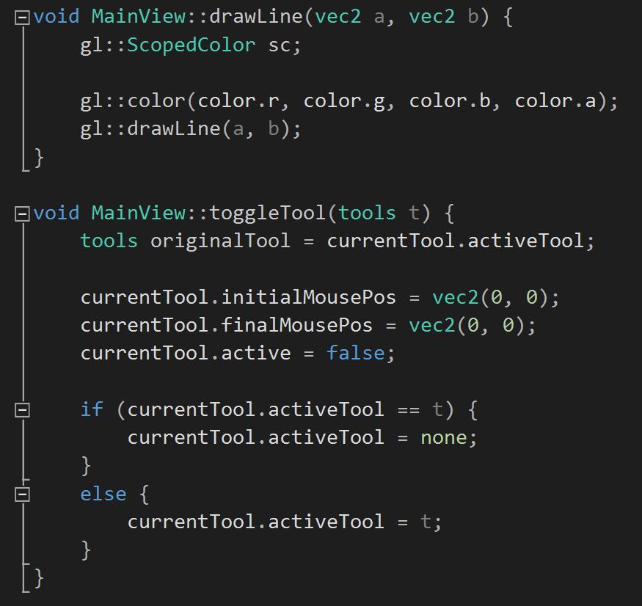
User Story #202 - Add tools to new Cinder integrated project (Screenshots)
Application after sprint:
Code sample:

Slide 10
Requirements: Use Cases
Notes:
5 seconds
Show the Use Case Diagram for the whole project. Highlight your use cases.

Slide 11
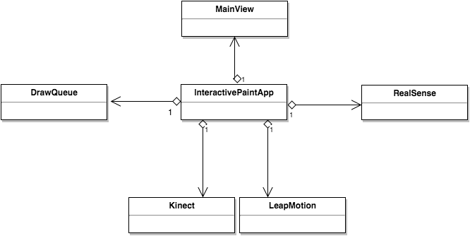
Minimal Class Diagram
Notes:
10 seconds.Minimal class diagram. Highlight the classes that you created/modified
Identify the design patterns used (one or more slides).

Slide 12
Test Suites and Test Cases
Integration Tests
This iteration of Interactive Paint was built as 3 disjoint projects and there was little integration.
The painting application built by Jose and Justin was tested by multiple users, each testing different features of the application.
Unit Tests
For the application built by Justin and Jose the methods that poll the input devices for data were tested, the methods that take that data and adjust it to make drawing easier were tested and the methods that draw to the screen were tested.
Notes:
10 seconds
A description of verification process and Test Suites and Test Cases for one of the use cases.
1 One sunny day and one rainy day for the implemented use cases (one or more slides).
2 Automated test scripts for the implemented use cases (if any) (one or more slides).

Slide 13
Unit Test Case for Interactive Paint
Sunny Day Case:
LeapMotion update method
Left and Right finger locations were forced to x = 0.5 y = 0.5
Input: screen height = 720, width = 1280
Expected Result: left and right finger locations should become x = 640 y = 360
Actual Result: left and right finger locations were x = 640 y = 360
LeapMotion isCircleGestureClockWise method
Input: Clockwise circle gesture
Expected Result: True
Actual Result: True
Rainy Day Case:
LeapMotion isCircleGestureClockWise method
Input: Swipe gesture
Expected Result: False
Actual Result: False

Slide 14








Summary
contact information:
Jacob Leschen Jlesc005@fiu.edu
Jose Morgan jmorg035@fiu.edu
Justin Alvarez jalva304@fiu.edu
Alain Galvan agalv023@fiu.edu
Questions?
Thank You!
Notes:
10 seconds
Summarize your contribution, mention your effort for Scrum, Mingle, Github, Google Drive Documentation and minutes
Include your contact information
Ask if anyone has any questions for you.
Thank your audience

